Slide 1
THE WAY WE WALK Google AI
Revolutionizing Health Care

Slide 2
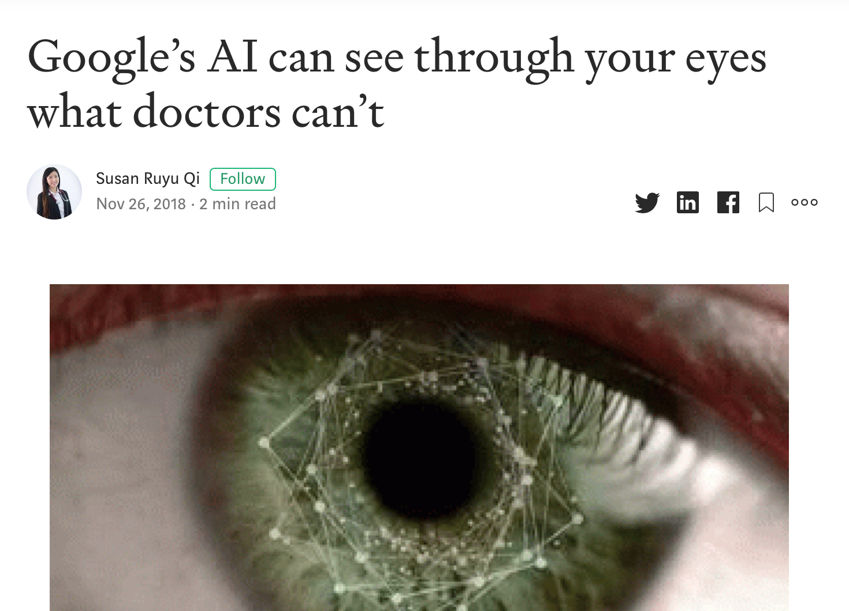
About the Article
Introduction
Article from 2018
AI could detect gender by looking at the Iris
Human Ophthanologists 50:50
Google’s AI: 97% AUC
Capable of diagnosing 50 ophthalmic conditions from 3D retinal OCT scans

Slide 3
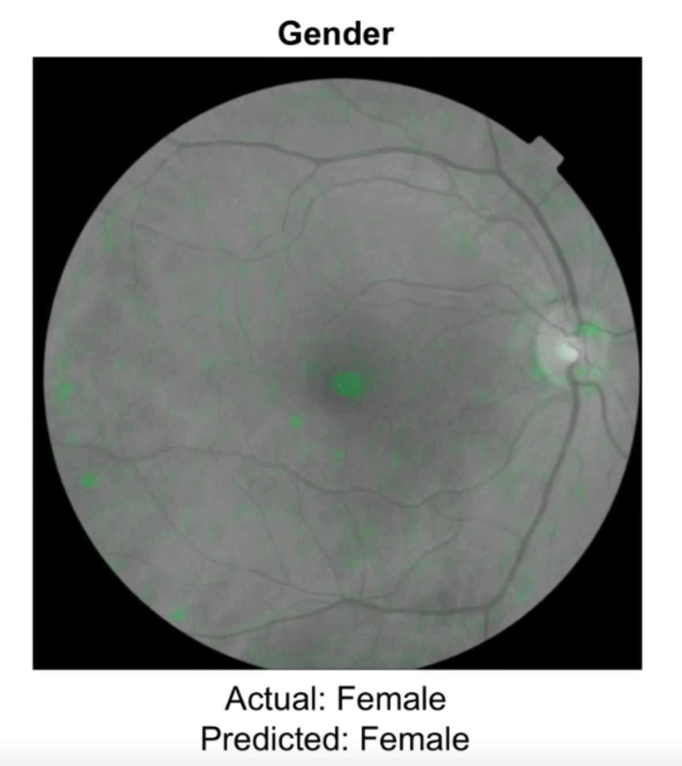
About the Article
Introduction
Generated ”Attention Maps” – humans couldn’t
71% → vessels;
78% → optic disc,
50% of the maps also highlighted non-specific features.
In other words, the neural network was looking at a bit of everything but nothing in particular…
Until this day – we didn’t even know that there was a difference in male and female eyes

Slide 4
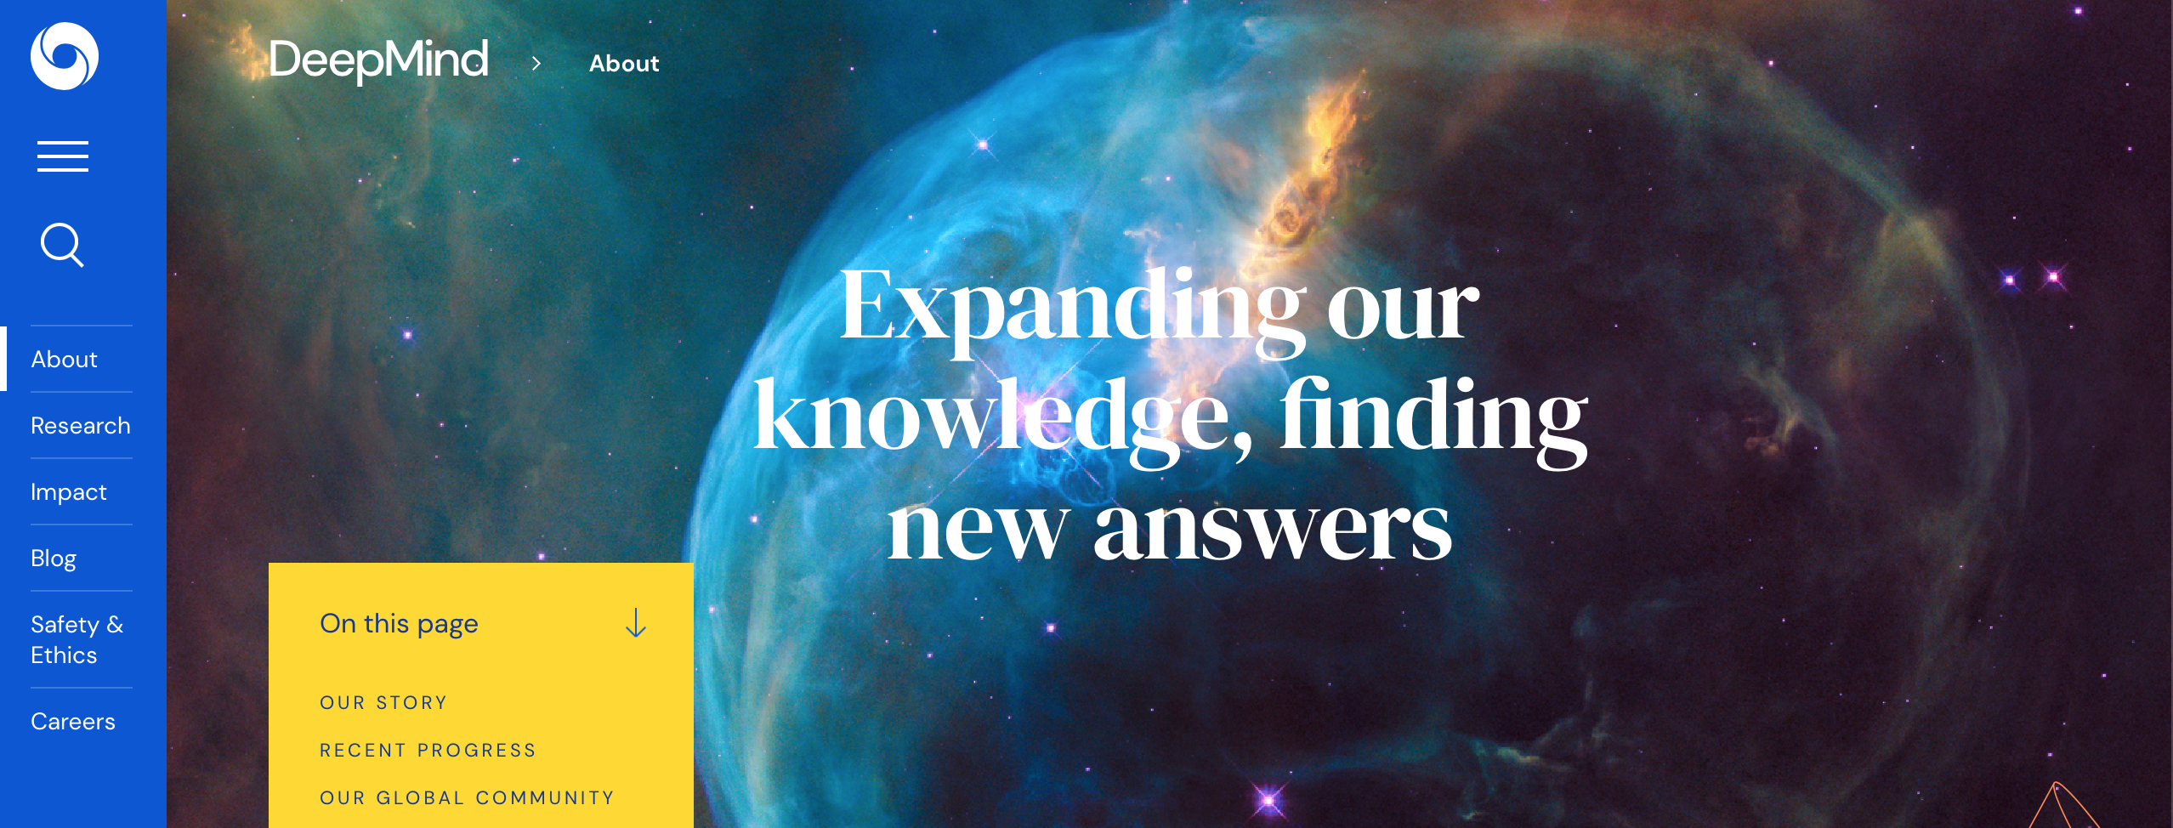
Behind the AI - Google’s DeepMind
Context
Founded in 2010, acquired by Google in 2014
Focus on value creation through AI, especially Neural Networks

Slide 5
Solving the Black Box Problem
Details
… has been one of the biggest barriers to the integration of AI technologies in healthcare → using TWO separate Neural Network instead of training only one
1) Segmentation Translates raw OCT scans into tissue maps
trained using 877 clinical OCT scans, 128 slices each
only 3 were manually classified
→ mimics the clinical decision process
→ helps gain insight into the AI’s decision process
learns
2) Classification Translates scanned slices into a diagnosis and referral pathway
Interprets and prioritizes results
urgent, semi-urgent, routine and observation-only

Slide 6
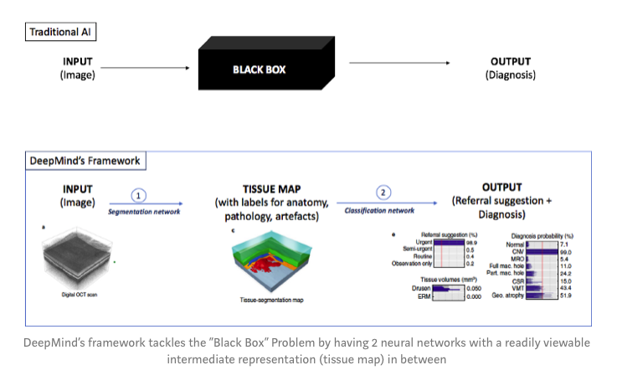
Solving the Black Box Problem
Details

Slide 7
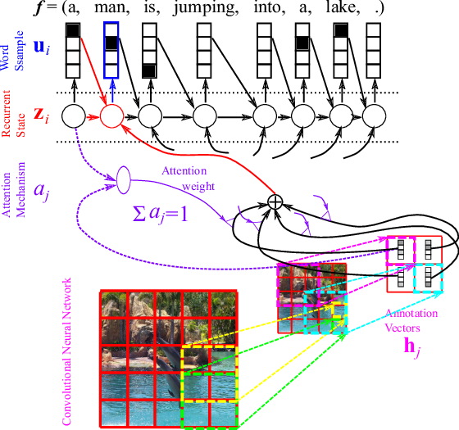
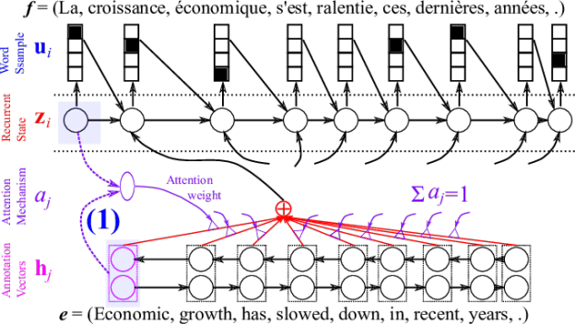
The Model
Explaining the Mechanism
Convolutional Neural Network & Recurrent Neural Network
A deep-learning technique called soft attention

Slide 8
The Model
Explaining the Mechanism

Slide 9
The Model
Explaining the Mechanism

Slide 10
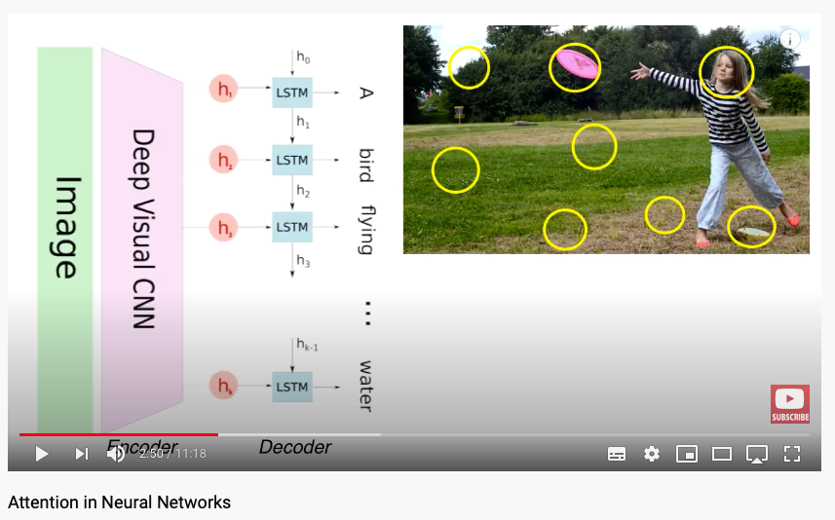
Explaining the Mechanism

Slide 11
Moral Aspects Related
Ethical Issues and Questionmarks
Medicine slipping into Corporate hands
Liability of Outcome if something goes wrong - Machine or Doctor?
“Anytime you talk about machine learning in medicine, the knee-jerk reaction is to worry that doctors are being replaced. But this is not going to replace doctors. In fact it’s going to increase the flow of patients with real disease who need real treatments,”
- Dr. Ehsan Rahimy, MD, a Google Brain consultant and vitreoretinal subspecial­ist in practice at the Palo Alto Medical Foundation.

Slide 12
Thank you for your Attention!

Slide 13
Sources & Credits
Google’s AI can see though your eyes what doctors can’t: Medium
Google DeepMind might have just solved the “Black Box” problem in medical AI: Medium
Deep Learning in Ophthalmology —How Google Did It: Medium
Using soft attention saliency maps for vision neural nets prediction interpretation: Medium
Attention in Neural Networks: Medium
Attention Neural Networks: YouTube

